Slide 1
Image Warping and Alignment
AJIT RAJWADE

Slide 2
Basics
A digital image – a version of the visual stimulus sampled at discrete locations, with discretized values
Can be regarded as a function I = f(x,y) where (x,y) are spatial (integer) coordinates in typically a rectangular domain Ω = [0,W-1] x [0,H-1].
Each ordered pair (x,y) is called a pixel.
The pixel is generally square (sometimes rectangular) in shape.

Slide 3
Basics
Pixel dimensions (height/width of the pixel) relate to the spatial resolution of the sensor in the camera that collects light reflected from a scene.
Remember: the actual visual signal is analog, but digital cameras capture a discrete version of it, and also quantize the intensity values.
That is they capture the visual stimulus only at specific points (x,y), usually evenly spaced from each other in both X and Y directions.

Slide 4
Basics
In a typical photographic grayscale image, the intensity values f(x,y) lie in the range from 0 to 255 (8 bit integers).
They are quantized versions continuous values corresponding to the actual light intensity that strikes a light sensor in the camera.

Slide 5
Image Alignment
Consider images I₁ and I₂ of a scene acquired through different viewpoints.
Pixels in physical correspondence (containing measurements of the same physical point, but not necessarily the same coordinate values in the image domain Ω)
Pixels in digital correspondence (same coordinate values in the image domain Ω, not necessarily containing measurements of the same physical point)

Slide 6
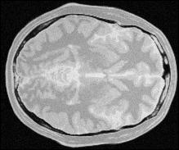
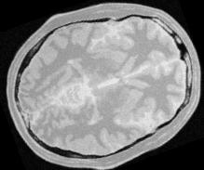
Image Alignment
I₁ and I₂ are said to be aligned if for every (x,y) in the domain Ω, the pixels at (x,y) in I₁ and I₂ are in physical correspondence.
If not, the images are said to be misaligned with respect to each other.
Or we say there is relative motion between the images.
Image alignment (also called registration) is the process of correcting for the relative motion between I₁ and I₂.
Image taken from the Brainweb database of the Montreal Neurological Institute

Slide 7
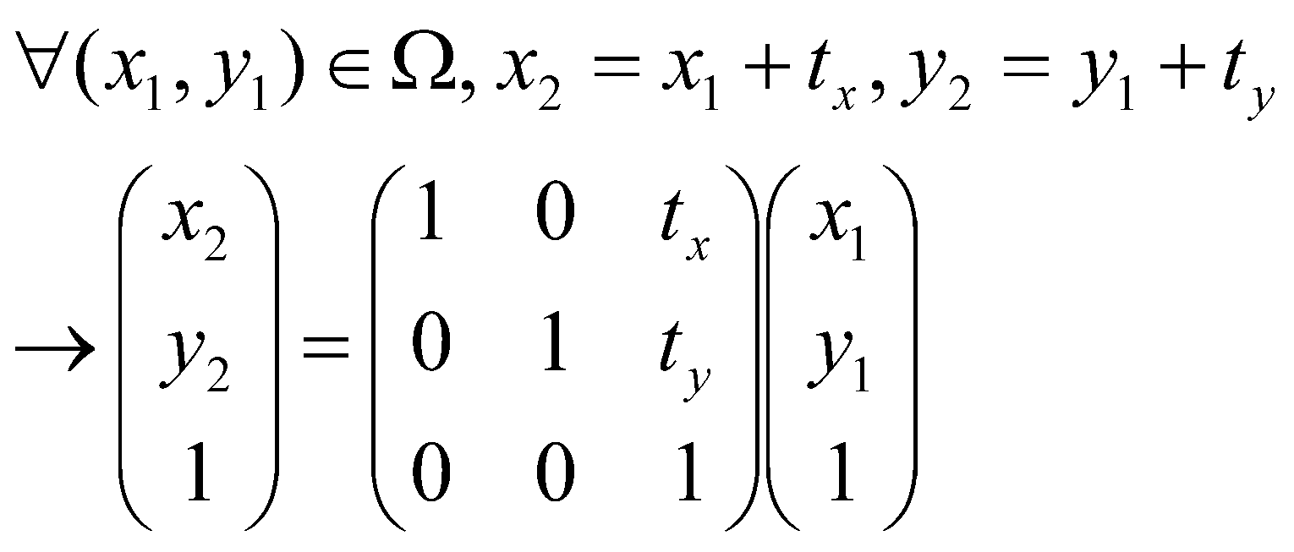
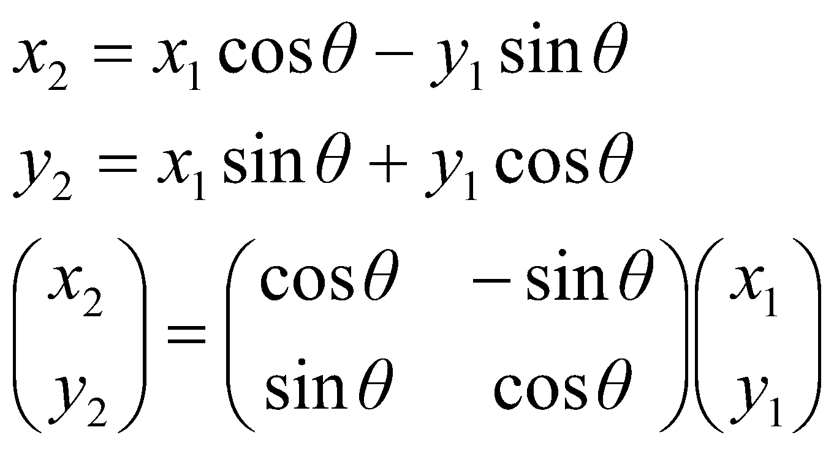
Motion Models
Let us denote the coordinates in I₁ as (x₁,y₁) and those in I₂ as (x₂,y₂).
Translation:
Rotation about point (0,0) anti-clockwise through angle θ
2D Rotation matrix (orthonormal matrix)

Slide 8
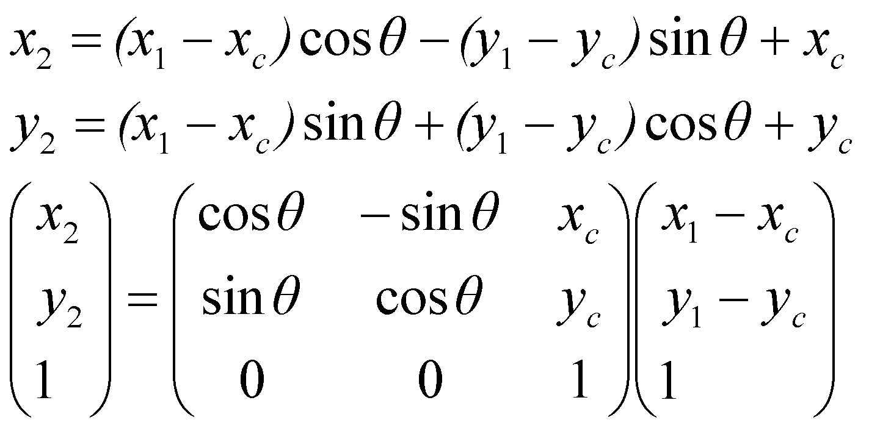
Motion Models
Rotation about point (x_{c},y_{c}) anti-clockwise through angle θ
-Perform translation such that (x_{c},y_{c}) coincides with the origin (0,0).
-Rotate about the new origin.
-Translate back.
-The extra ones (third row) are called homogeneous coordinates – they facilitate using matrix multiplication to represent translations.

Slide 9
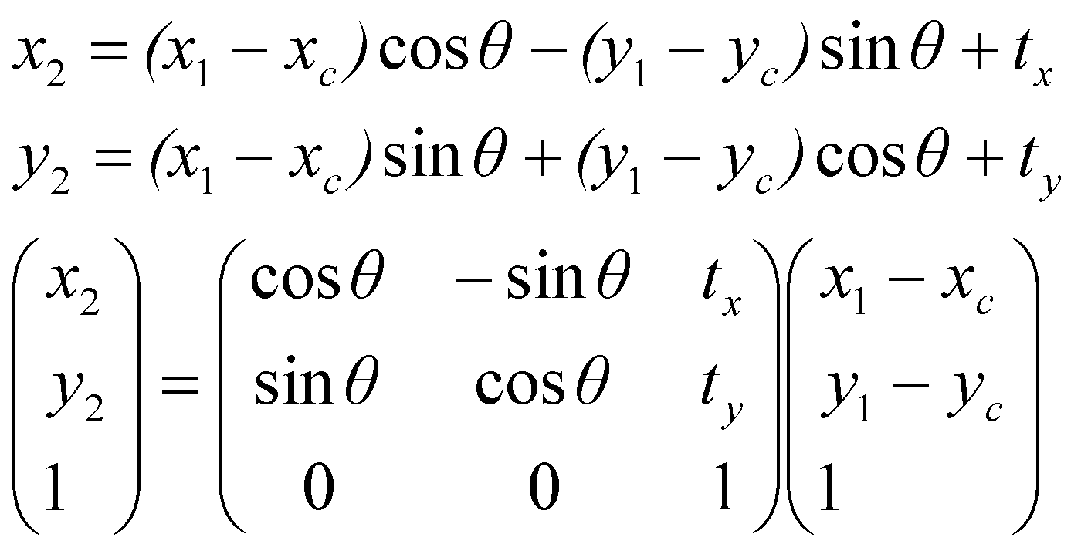
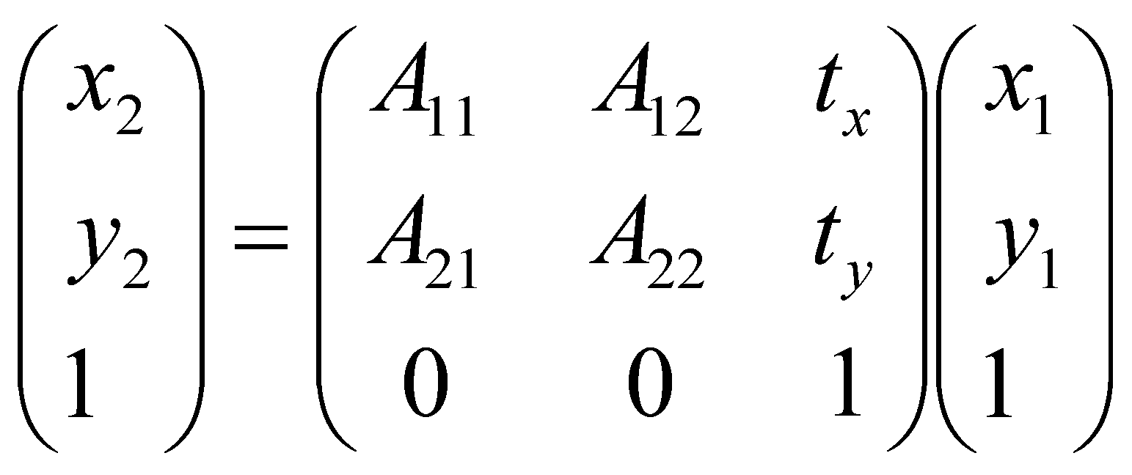
Motion Models
Rotation and translation:
Affine transformation: (rotation, scaling and shearing) besides translation
Assumption: the 2 x 2 sub-matrix A is NOT rank deficient, otherwise it will transform two-dimensional figures into a line or a point

Slide 10
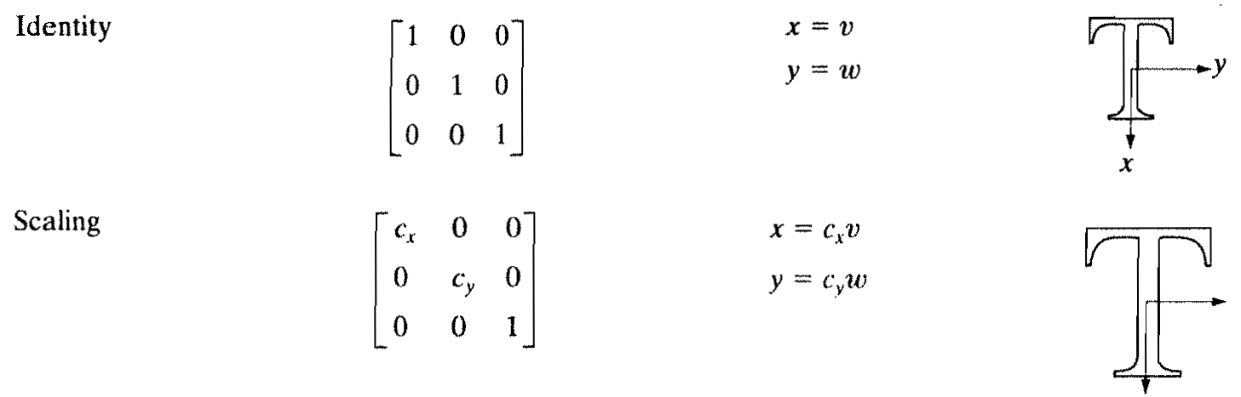
Motion Models
Scaling about the origin

Slide 11
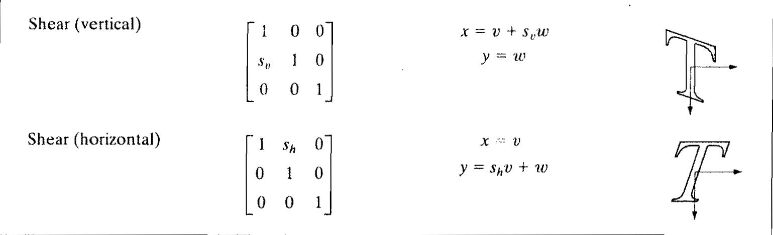
Motion Models
Shearing:

Slide 12
Motion Models
The 2D affine motion model (including translation in X and Y direction) includes 6 degrees of freedom.
Note: this motion model accounts for in-plane motion only (example: not an appropriate model for “3D head profile view versus head frontal view”)
Note: even with in-plane motion, there exist more complicated motion models, but we will stick to this one for now.

Slide 13
Motion Models
Composition of multiple types of motion is given by the multiplication of their corresponding matrices.
So, if you first scale (matrix S) and then rotate (matrix R), then the resultant transformation = RS.
Note: most motion compositions are not commutative (RS is not equal to SR).

Slide 14
Motion Models
In actual coding, you will typically not use matrices.
Rather you will implement the formula as is.
So why is matrix-based motion representation useful?
Because it allows for a compact way to represent the composition of many different types of motion.

Slide 15
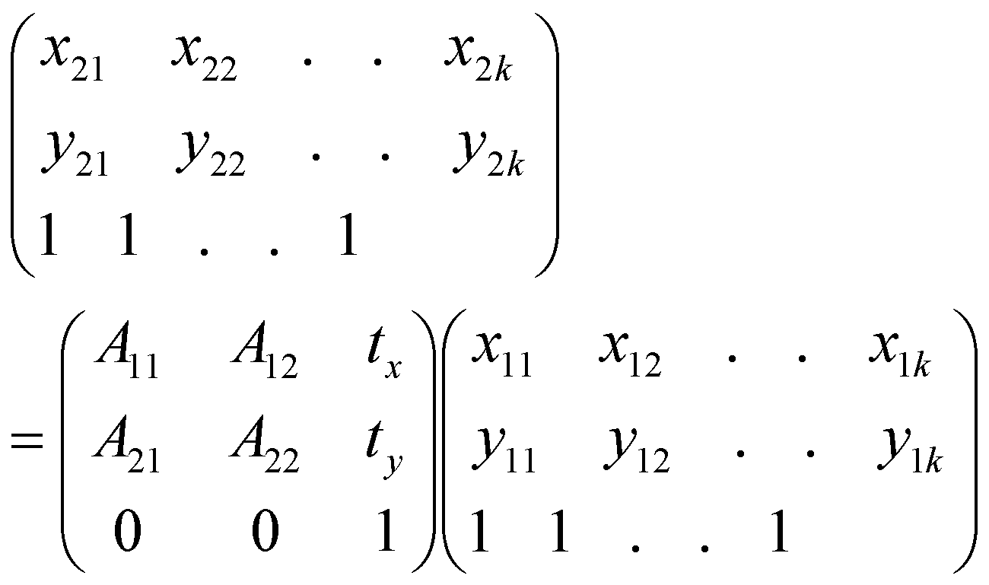
Alignment with control points
Solve for unknown parameters using least-squares framework (i.e. pseudo-inverse)
Apply the motion based on these parameters to the first image
Control points: pairs of physically corresponding points – maybe marked out manually, or automatically using geometric properties of the image.
Number of control points k MUST be
>= u/2, where u = number of unknown parameters in the motion model (each point has two coordinates – x and y). The number of control points is several times smaller than the number of image pixels.

Slide 16
Alignment with control points
Not always feasible, if it requires manual intervention
Error-prone
There are methods for finding matching control points automatically (eg: the popular SIFT technique), but we will not cover them in this course.

Slide 17
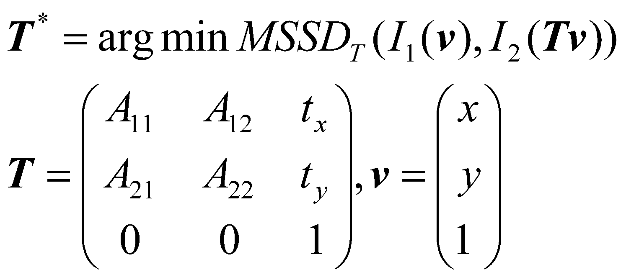
Alignment with mean squared error
Mean squared error is given by:
Find motion parameters as follows:
Find transformation matrix T which produces the least value of MSSD

Slide 18
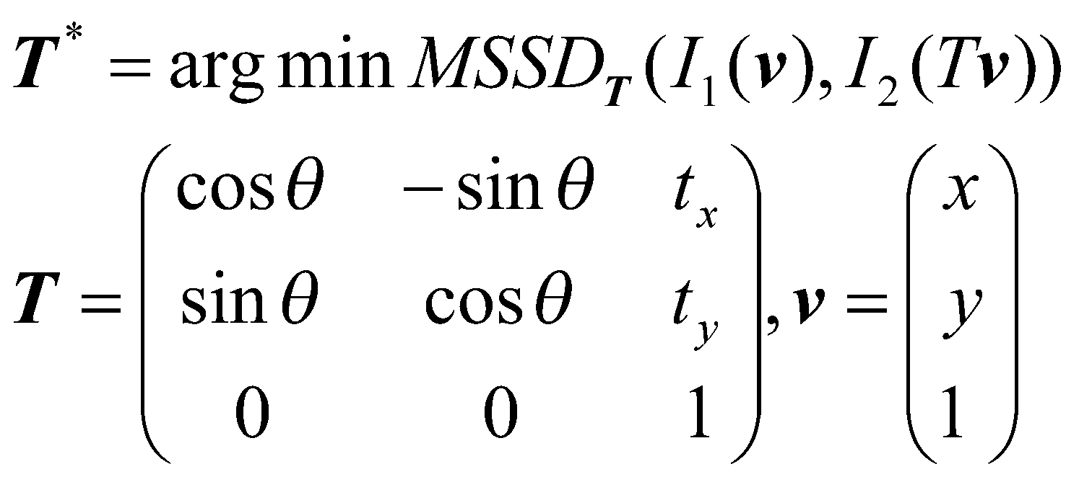
Alignment with mean squared error
For simplicity, assume there was only rotation and translation.
Then we have

Slide 19
Alignment with mean-squared error
There are many ways to do this minimization. The simplest but least efficient way is to do a brute-force search.
Sample θ, t_{x} and t_{y} uniformly from a certain range (example: θ from -45 to +45, t_{x} or t_{y} from -30 to +30).
Apply this motion to I₁ keeping I₂ fixed (alternatively to I₂ keeping I₁ fixed, if the matrix is invertible), and compute the MSSD.
Each time, compute the MSSD. Pick the parameter values corresponding to minimum MSSD.

Slide 20
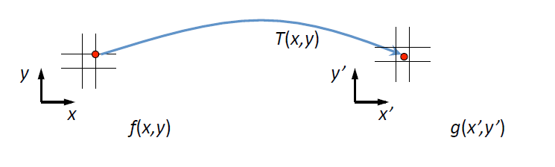
Image Warping
Forward warping method:
Apply the transformation T to every coordinate vector v = [x y] in the original image to yield new coordinate Tv.
Copy the intensity value from v in the original image to the new location in the warped image. Careful handling is needed if Tv is not an integer (highly likely).

Slide 21
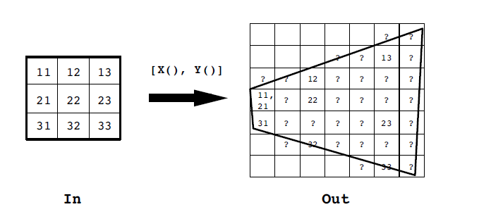
Image Warping
Forward warping:
-Can leave the destination image with some holes if you scale up.
-Can lead to multiple answers in one pixel if you scale down.

Slide 22
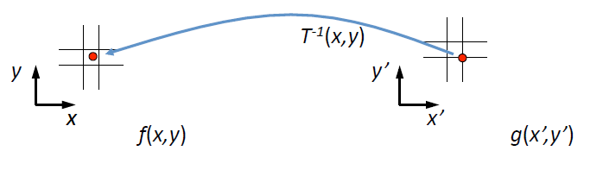
Image warping
Reverse warping:
For every coordinate v = [x y] in the destination image, copy the intensity value from coordinate T⁻¹v in the original image.
In case of non-integer value, perform interpolation (nearest neighbor or bilinear)

Slide 23
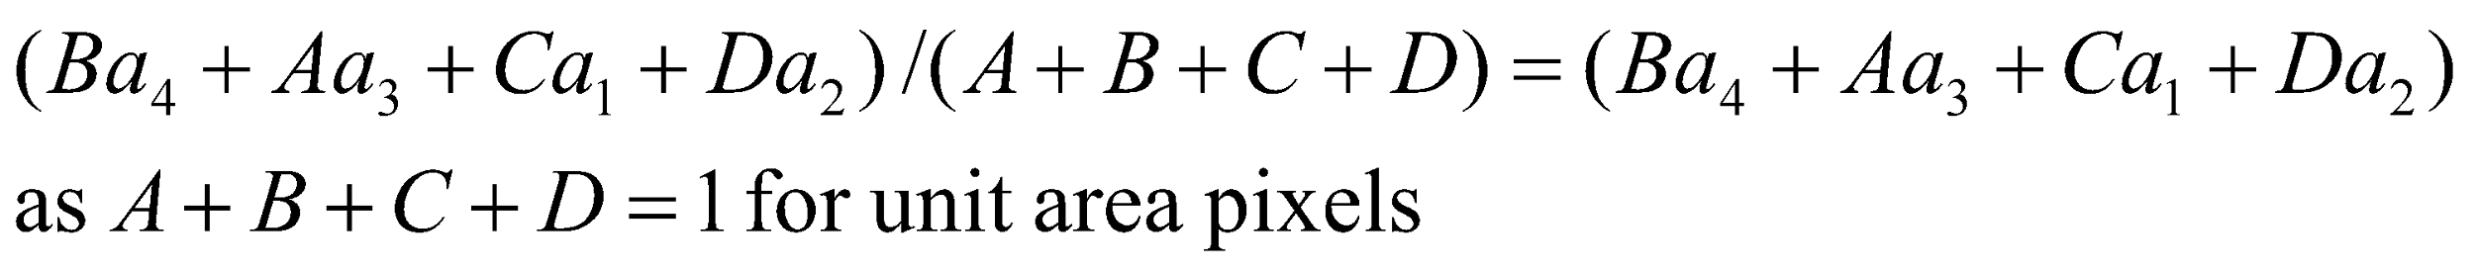
Interpolation
a1
a2
Nearest neighbor method:
Use value a₄ (as the pixel that is nearest to the red point contains value a₄)
Bilinear method:
Use the following value, a weighted combination of the four neighboring pixel values, with more weight to nearer values:
A
B
D
C
a4
a3

Slide 24
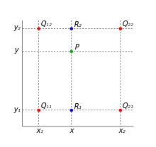
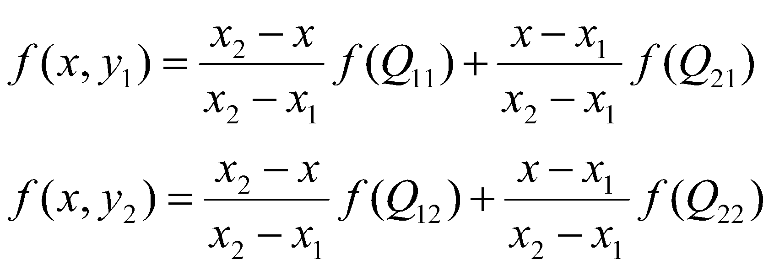
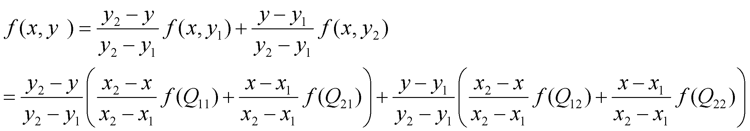
Bilinear interpolation in more detail
We interpolate first in the X direction:
In both cases, notice that higher weight is given to the pixels that are closer to P.
We then interpolate first in the Y direction:

Slide 25
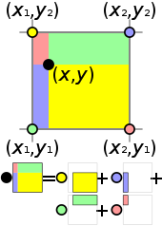
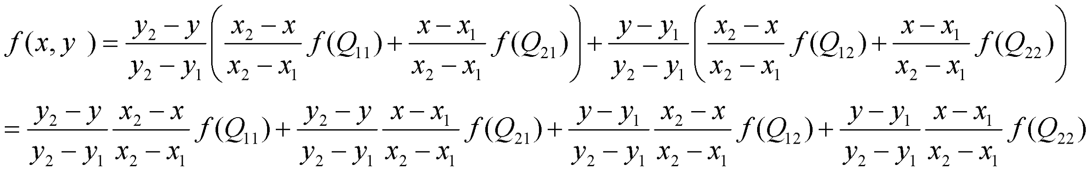
Bilinear interpolation in more detail
This formula will remain unchanged if you first interpolated in the Y direction and then in the X direction. Verify this yourself.

Slide 26
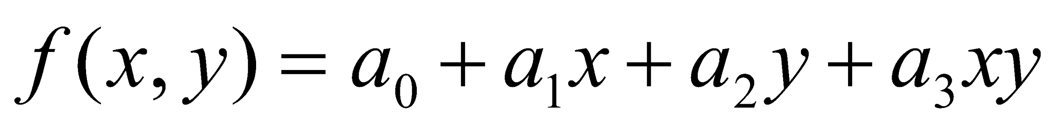
Bilinear interpolation in more detail
Here we are approximating the image intensity in the form of the following bilinear function:
Here a₀, a₁, a₂, a₃ are scalar coefficients. The value of f(x,y) is known at the four corners of a pixel.
The function would have been linear if the term in xy were absent (i.e. if a₃ = 0).

Slide 27
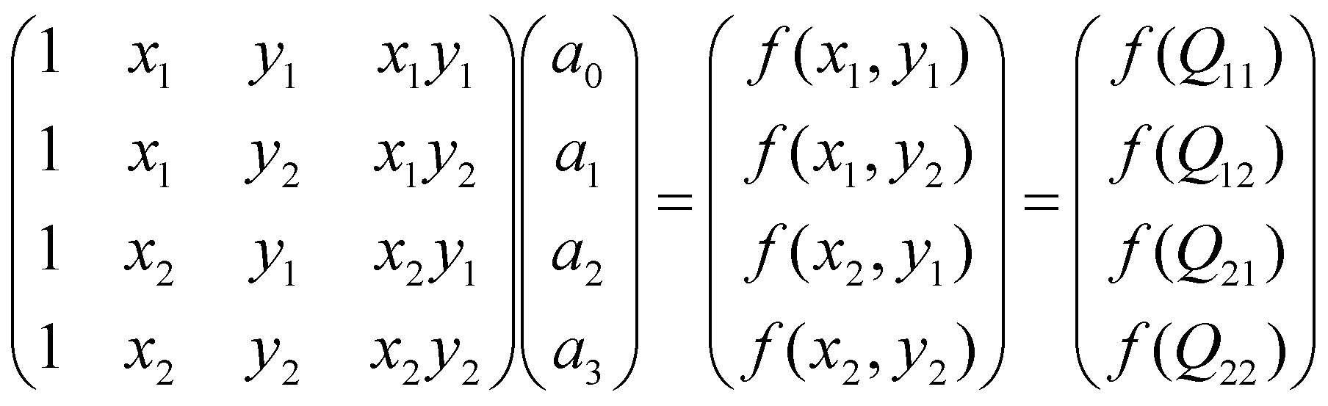
Bilinear interpolation in more detail
How do we determine the coefficients a₀, a₁, a₂, a₃ ?
These coefficients can be obtained by inverting the 4 x 4 matrix.
It can be shown (through tedious calculations) that the result of this is equivalent to the formula we derived earlier.

Slide 28
Alignment with mean squared error
In the ideal case, the MSSD between two perfectly aligned images is 0. In practice, it will have some small non-zero value even under more or less perfect alignment due to sensor noise or slight mismatch in pixel grids.

Slide 29
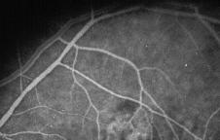
Careful: field of view issues!
Fixed image (also called reference image)
Region of overlap (also called field of view) when the moving image is warped
Note: compute MSSD only over region of overlap.

Slide 30
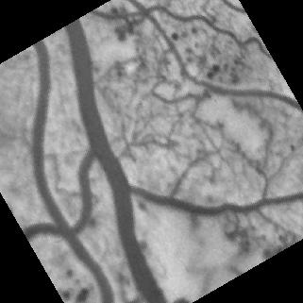
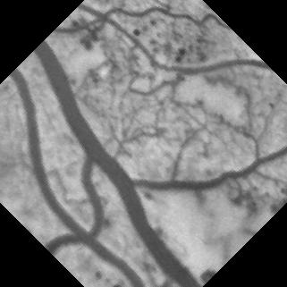
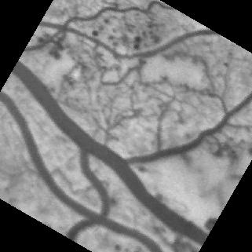
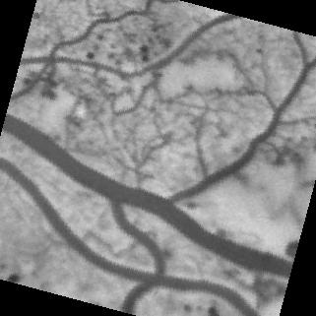
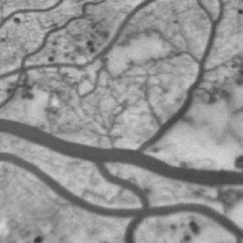
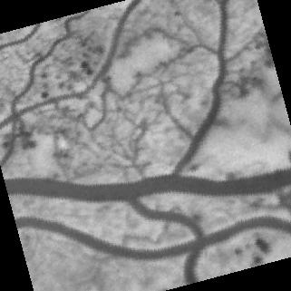
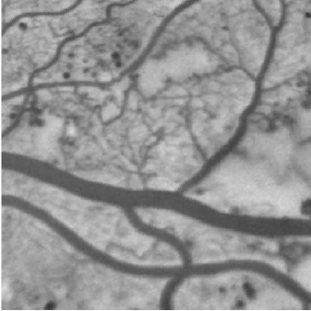
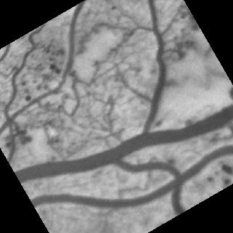
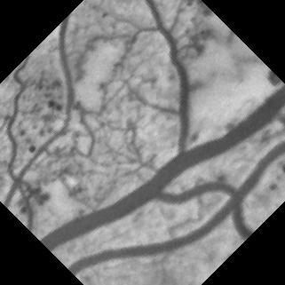
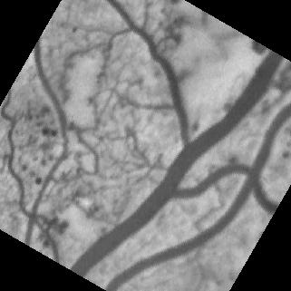
Change in region of overlap (also called field of view), as the moving image is warped. The field of view in any of these figures consists of all those pixels not marked black. It represents the set of pixels (x,y) where both I₁(x,y) and I₂(x,y) are well defined.
-60
-45
-30
-15
0
+15
+30
+45
+60

Slide 31
Alignment with mean squared error
MSSD is called an “image similarity metric”.
MAJOR ASSUMPTION: Physically corresponding pixels have the same intensity!

Slide 32
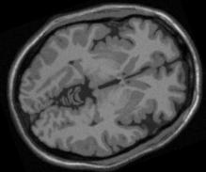
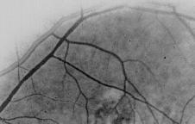
Image alignment: Intensity changes in images
Images acquired by different sensors (MR and CT, camera with and without flash, etc.)
Changes in lighting condition
MR-PD
MR-T1

Slide 33
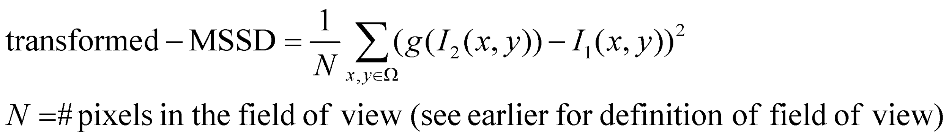
Image alignment: Intensity changes in images
If following relationship (function g) exists and we knew it, the solution is easy:
Physically corresponding points

Slide 34
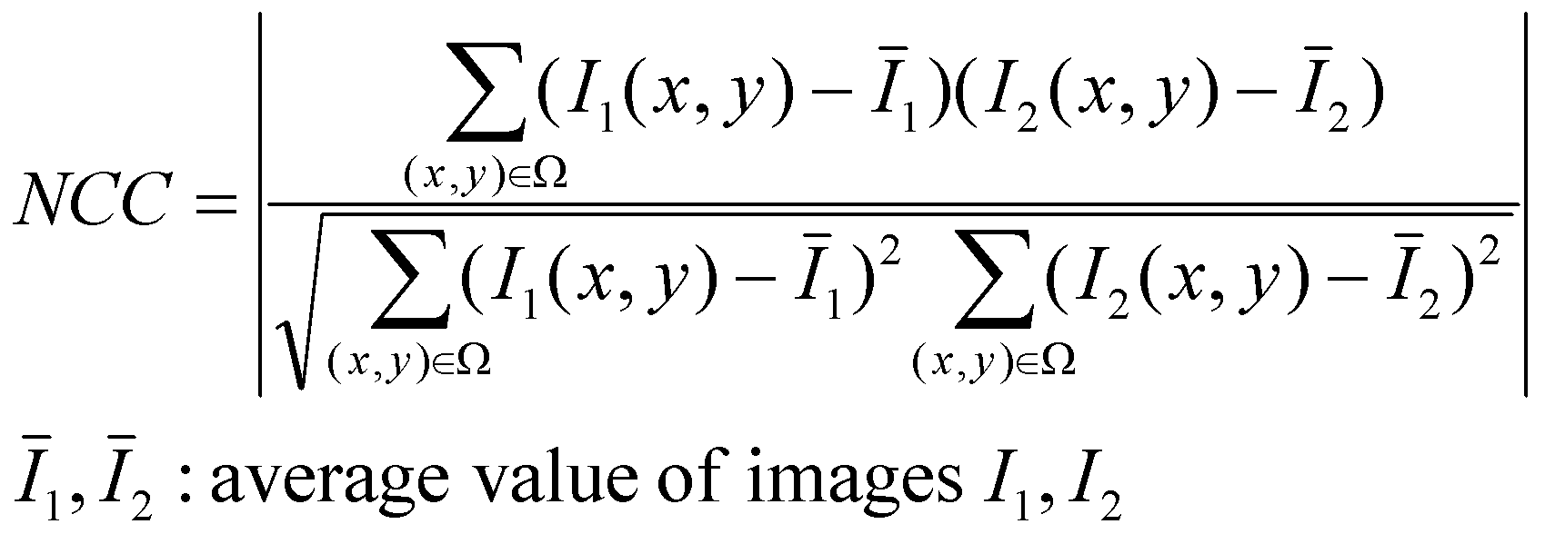
Image alignment: Intensity changes in images
What if the relationship exists in the following linear form, but we knew it only partially?
Physically corresponding points
Normalized cross-correlation, also called correlation-coefficient
We are taking the absolute value here, to take care of cases where one image has positive values and the other has negative values. We are assuming a linear relationship between the intensities of I1 and I2 but we do not assume knowledge of the scalar coefficients a and b.

Slide 35
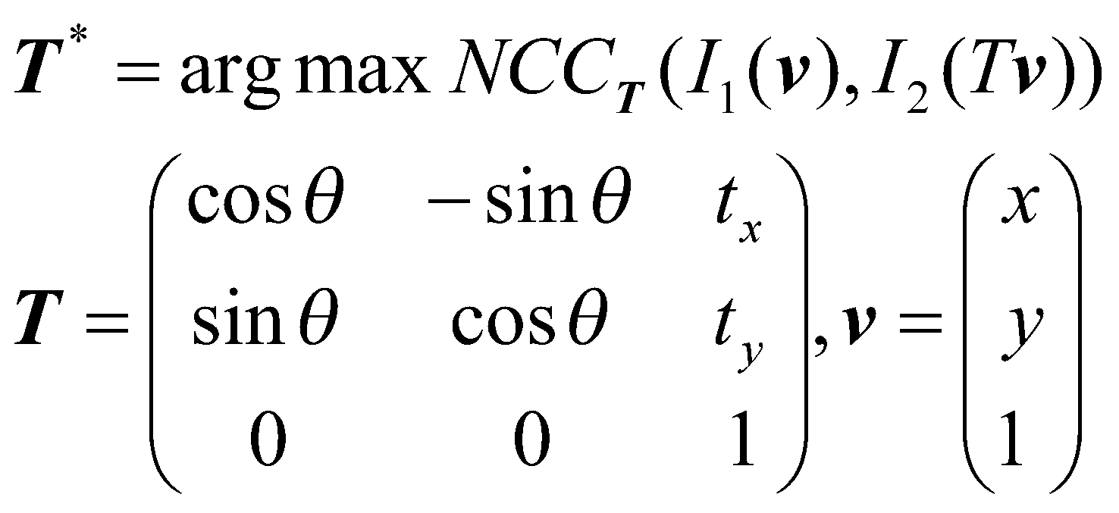
Image alignment: Intensity changes in images
Normalized cross-correlation, also called correlation-coefficient.
The NCC is like the absolute normalized dot product between mean-deducted images.

Slide 36
Image alignment: intensity changes in images?
Assume there exists a functional relationship between intensities at physically corresponding locations in the two images.
But suppose we didn’t know it (most practical scenario) and couldn’t find it out.
We will use image histograms!

Slide 37
Image Histogram
In a typical digital image, the intensity levels lie in the range [0,L-1].
The (normalized) histogram of the image is a discrete function of the form p(r_{k}) = n_{k}/HW, where r_{k} is the k-th intensity value, and n_{k} is the number of pixels with that intensity. (H,W = image dimensions)
Sometimes, we may consider a range of intensity values for one entry in the histogram, in which case r_{k} = [r^{min}_{k}, r^{max}_{k}] represents an intensity bin, and n_{k} is the number of pixels whose intensity falls within this bin.
Note p(r_{k}) >= 0 always, and all the p(r_{k}) values sum up to 1.

Slide 38
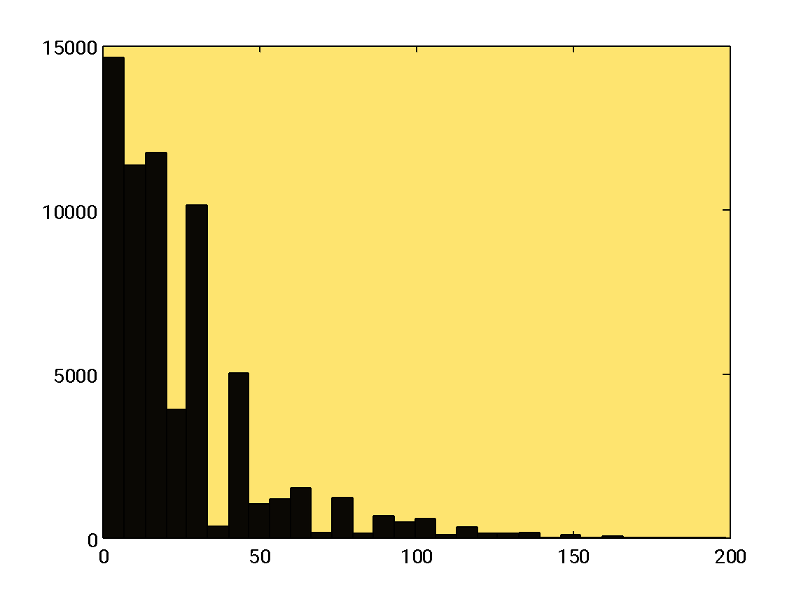
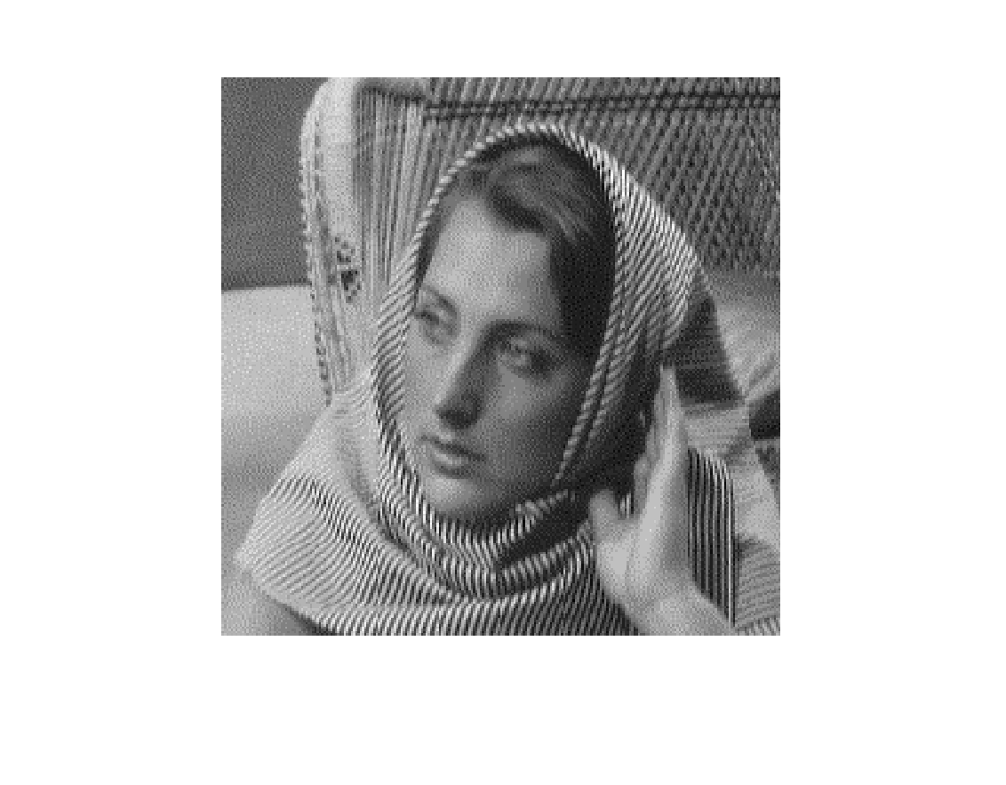
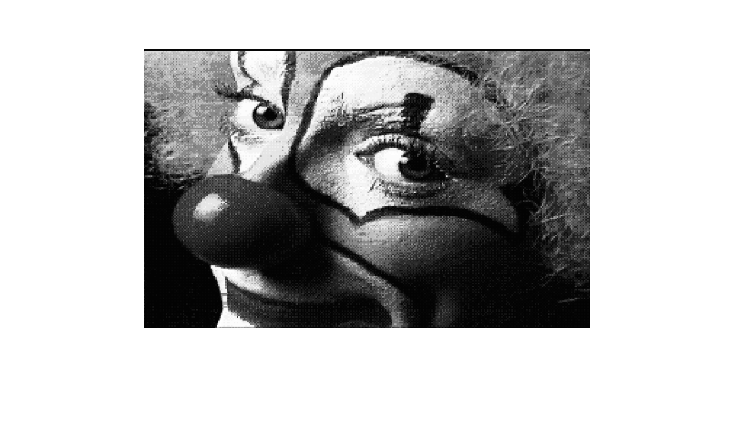
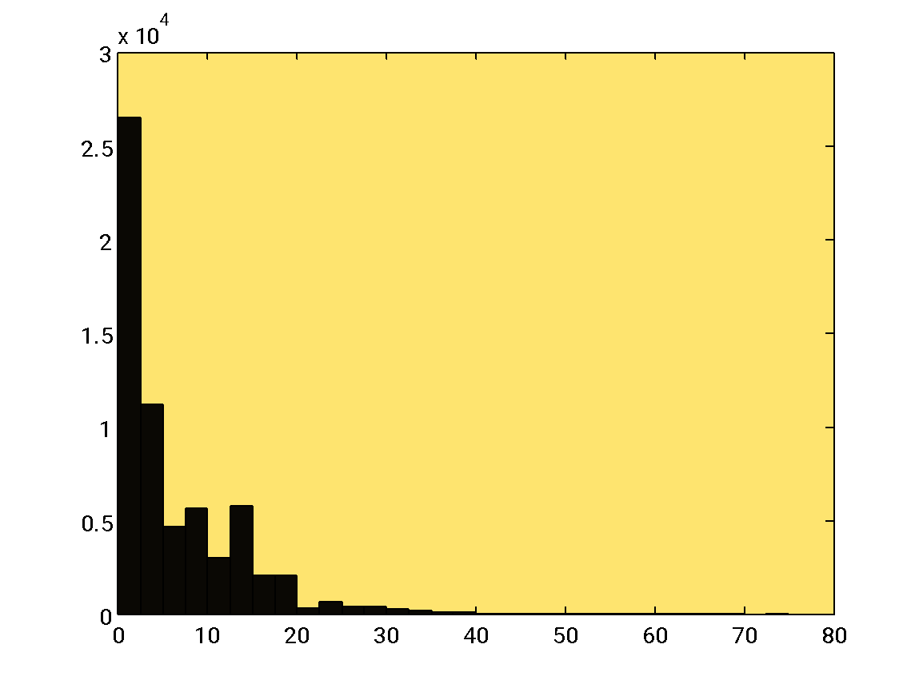
These are unnormalized histograms of two different images. That is, the entries of the histogram represent frequencies in this case without division by HW = #pixels.

Slide 39
Joint Image Histogram
A joint image histogram is a function of the form p(r_{k1},r_{k2}) where r_{k1} and r_{k2} represent intensity bins from the two images I₁ and I₂ respectively.
p(r_{k1},r_{k2}) = number of pixels (x,y) such that I₁(x,y) and I₂(x,y) lie in bins r_{k1} and r_{k2} respectively, divided by HW.

Slide 40
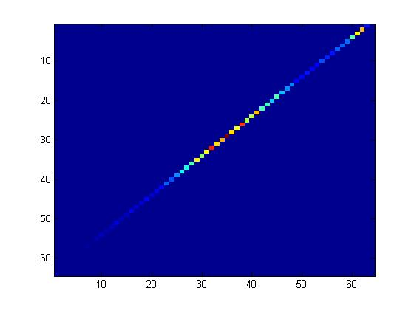
I₁
Values in I₂
from 0 to 60
Values in I₁ (from 0 to 60)
Registered images: joint histogram plot looks “streamlined”
I₂

Slide 41
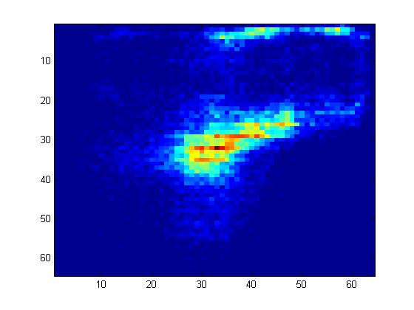
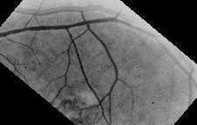
Values in I₂
from 0 to 60
Values in I₁ (from 0 to 60)
Misaligned images: joint histogram plot looks “dispersed”
We need a method to quantify how dispersed a joint histogram actually is.

Slide 42
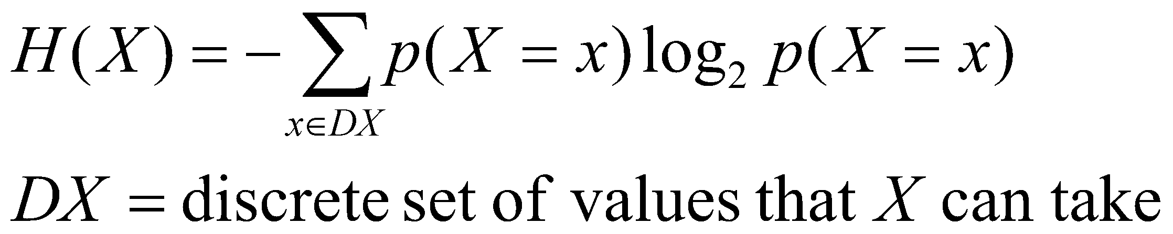
Measure of dispersion
Consider a discrete random variable X with normalized histogram p(X) [also called the probability mass function].
The entropy of X is a measure of the uncertainty in X, given by the following formula:
Note: entropy is a function of the normalized histogram of X.
Not a function of the actual values of X.
The entropy is always non-negative.

Slide 43
Entropy
The entropy is maximum if X has a discrete uniform distribution, i.e. p(X=x₁) = p(X=x₂) for all values x₁ and x₂ in DX. The maximum value is log(|DX|).
The entropy is minimum (zero) if the normalized histogram of X is a Kronecker delta function, i.e. p(X= x₁) = 1 for some x₁, and p(X= x₂) = 0 for all x₂ ≠ x₁.

Slide 44
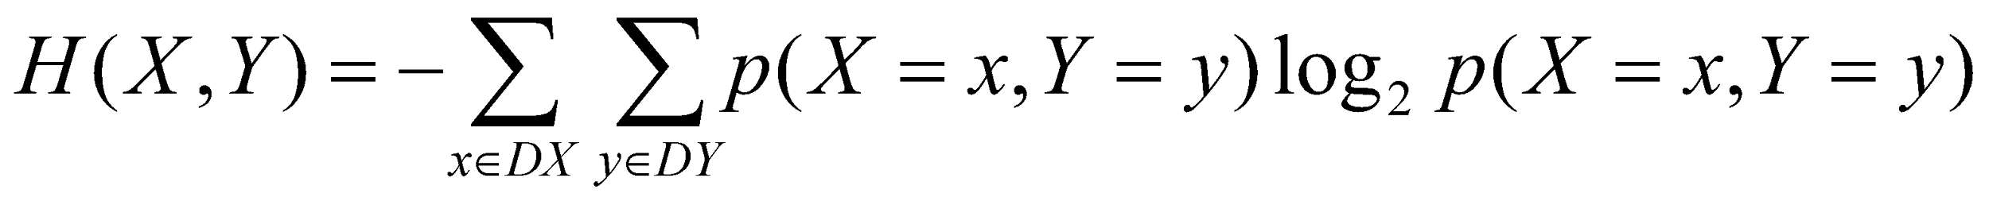
Joint entropy
The joint entropy of two random variables X and Y is given as follows:
Maximum entropy:
-Uniform distribution on X and Y: entropy value log(|DX||DY|) where DX, DY are the set of discrete values that X and Y can acquire
Minimum entropy:
-Kronecker delta (i.e. a PMF will all probability concentrated on only one entry with others being 0): entropy value 0 = non uncertainty

Slide 45
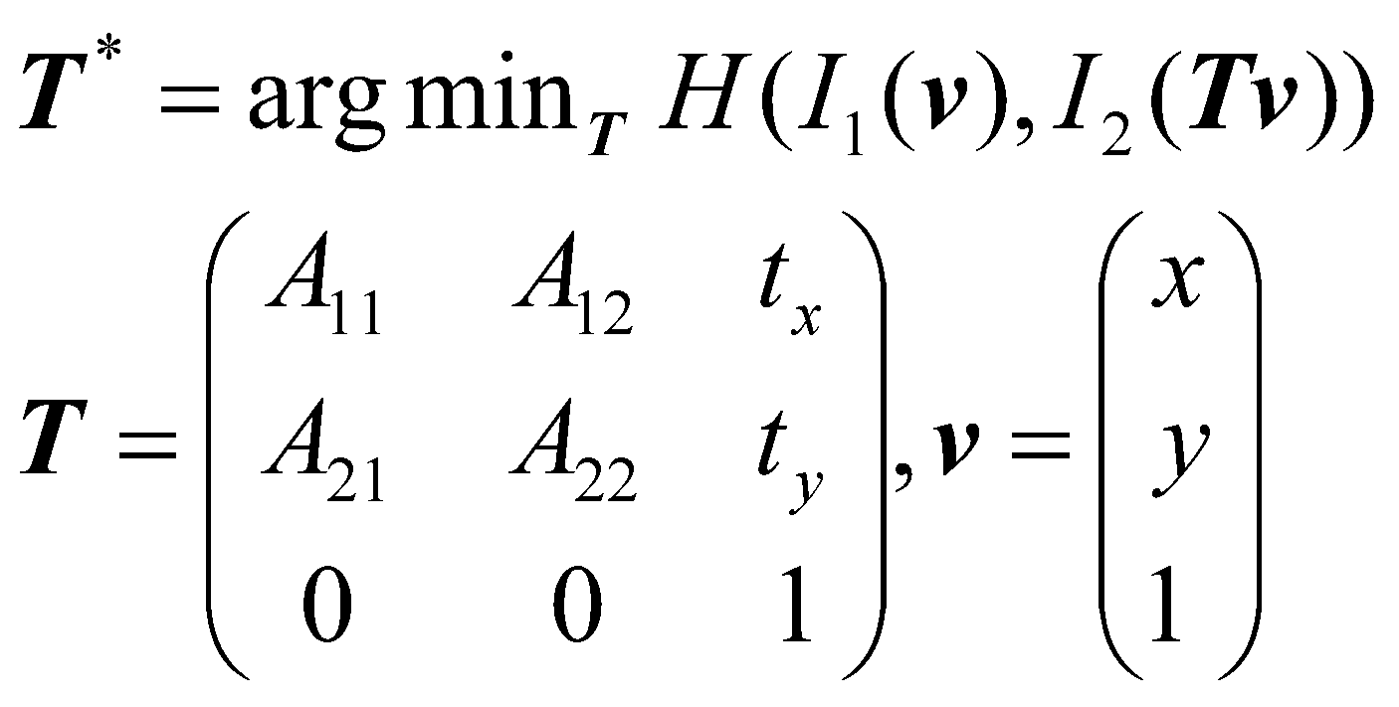
Joint entropy
Minimizing joint entropy is one method of aligning two images with different intensity profiles.

Slide 46
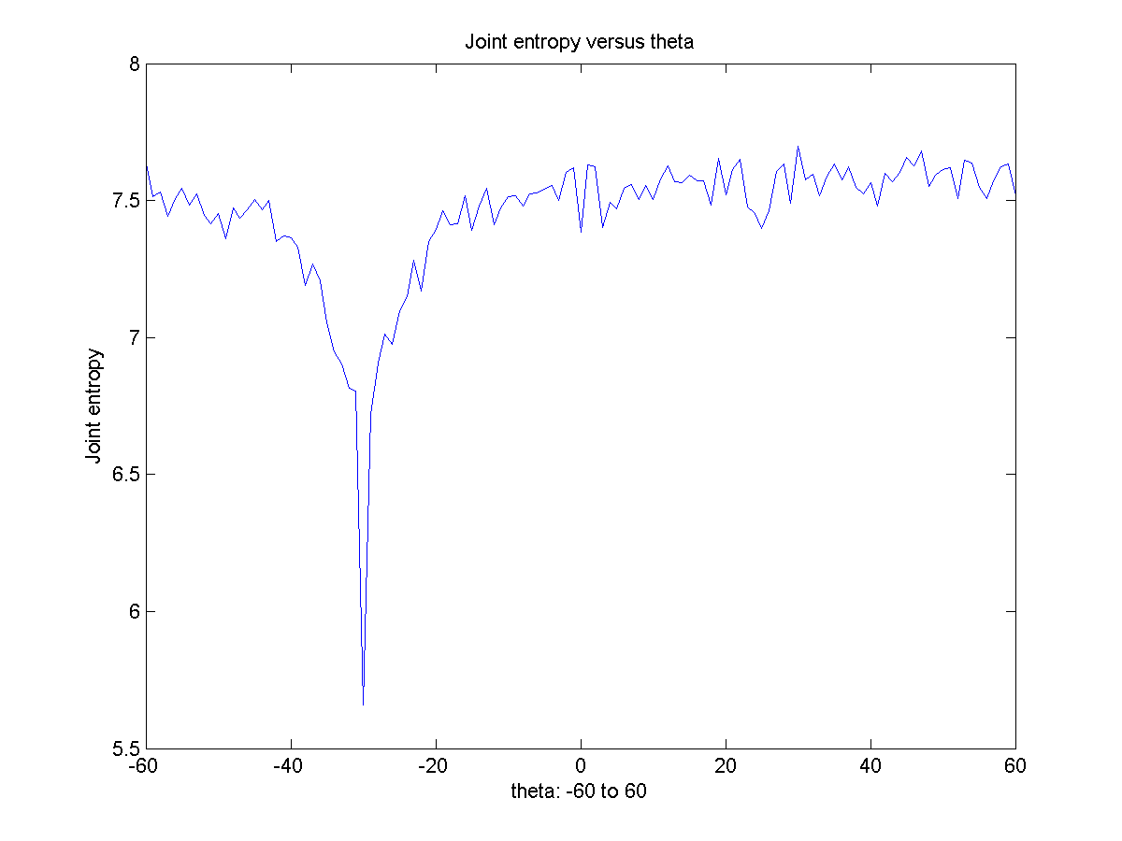


I1
I2: obtained by squaring the intensities of I1, and rotating I1 anticlockwise by 30 degrees.
I2 treated as moving image, I1 treated as fixed image. Joint entropy minimum occurs at -30 degrees.

Slide 47
Components of an Image Alignment Algorithm
Choice of a metric to optimize (joint entropy or mean squared error)
Choice of a motion model (only translation, translation + rotation, affine, etc.)
Choice of an interpolation algorithm to generate the warped image
Choice of an optimization algorithm (here, we just used brute force search)

Slide 48
Image Alignment: applications, related problems
Template matching
Image Panoramas

Slide 49




Template Matching
Look for the occurrence of a template (a smaller image) inside a larger image.
Example: eyes within face image
Templates

Slide 50
Template matching
Let T = template image (smaller) of size h x w and J = larger image of size H x W
For every pixel (x,y) in J, consider a portion z_{xy} = J(x:x+w-1,y:y+h-1)
Select the portion z_{xy} with smallest MSSD compared to T
In some variants, the larger image J may be rotated with respect to T.
In such cases, repeat the above procedure for every rotation of J from (say) -90 to +90 degrees.
That is for every θ from -90 to +90 degrees, let J_{θ} be a rotated version of J. Now consider all z_{xy} in J_{θ} and report the (x,y, θ) triple that produces the least MSSD with respect to T.

Slide 51

Image Panoramas
http://cs.bath.ac.uk/brown/autostitch/autostitch.html
A camera has a limited field of view. A scene may have much larger “area” than what can be captured from a single camera.
So one can acquire multiple images, each from a different viewpoint, and you need to stitch these together to form a panorama or mosaic. The stitching involves more complicated motion models (called homography) than what you have studied in this course.

Slide 52
What we learnt..
Affine motion model
Forward and reverse image warping
Field of view during image alignment
Measures for Image alignment: sum of squared differences, normalized cross-correlation, joint entropy

Slide 53
What we didn’t learn
Complicated motion models: higher degree polynomials, non-rigid models (example: motion of an amoeba, motion of the heart during the cardiac cycle, facial expressions, etc.)
Efficient techniques for optimizing the measure for image alignment

